Slide 1
LOAN DEFAULT PREDICTION USING PYTHON , EDA & ML
Team Members:
A - Data cleaning +preprocessing :Sandhiya .S
B - EDA & Visualization : Vidhyalakshmi R.V
C - ML Model Building :Divya.K
D - Dashboard & Final PPT : Zabiullah

Slide 2

INTODUCTION:
Individuals All around the world in some way depend on banks to lend them loans for various reasons to help them overcome their financial constraints and achieve some personal goals
Loans is the major source of income for the banking sector as well as the biggest source of financial risk for banks.

Slide 3
DATASET DESCRIPTION
Training & Test datasets
~ 600 rows , 20+ columns
Includes Loan_ID, Income , Credit History, etc.
Target Variable:
- Default (1=Yes, 0= No)

Slide 4
DATA CLEANING
Removing NAN
Dealing with Outliers
Duplicates
Missing value
Renaming the some variable name

Slide 5
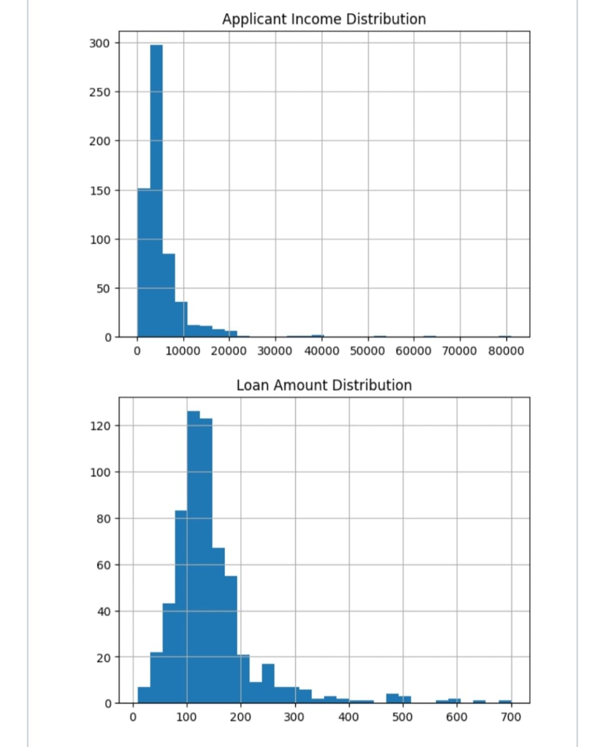
EDA(Exploratory Data Analysis)
Credit History distribution
Property Area wise loan approvals
Univariate Analysis :Histograms,Boxplots

Slide 6
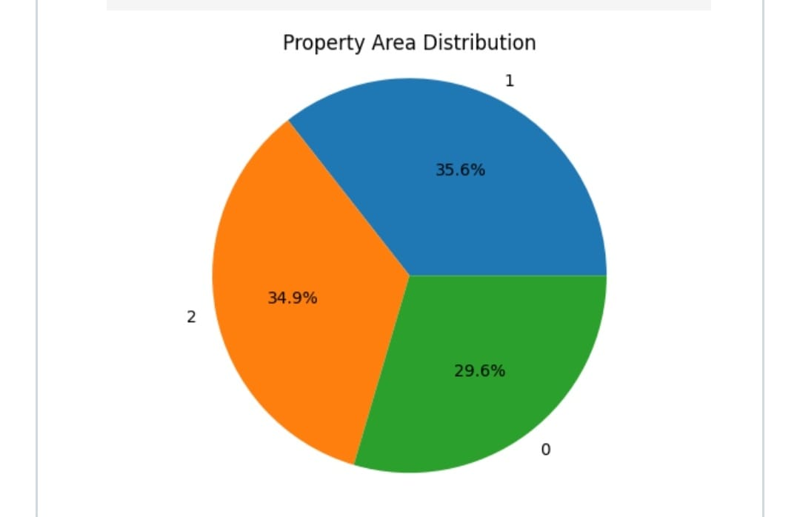
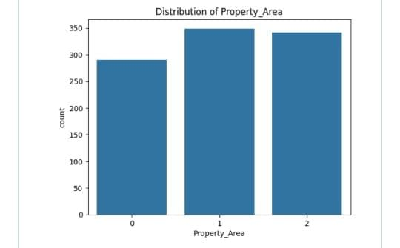
Loan status

Slide 7
MACHINE LEARNING MODEL
Supervised Learning Platform
Classification Algorithm:
- Logistic Regression
-Decision Trees
Libraries Used:
- Scikit-learn, Pandas,Matplotlib

Slide 8
TRAINING AND EVALUATION
Train/Test split :80/20
Metrics Evaluated :Accuracy , Precision , Recall , F1-score
Best Model :Random Forest (Accuracy:83%)

Slide 9
CONCLUSION
Machine Learning enhances loan default predication
Further refinements can improve performance and align with business goals.
Credit history is the most critical factor
Discovered insights from EDA

